Slide 1
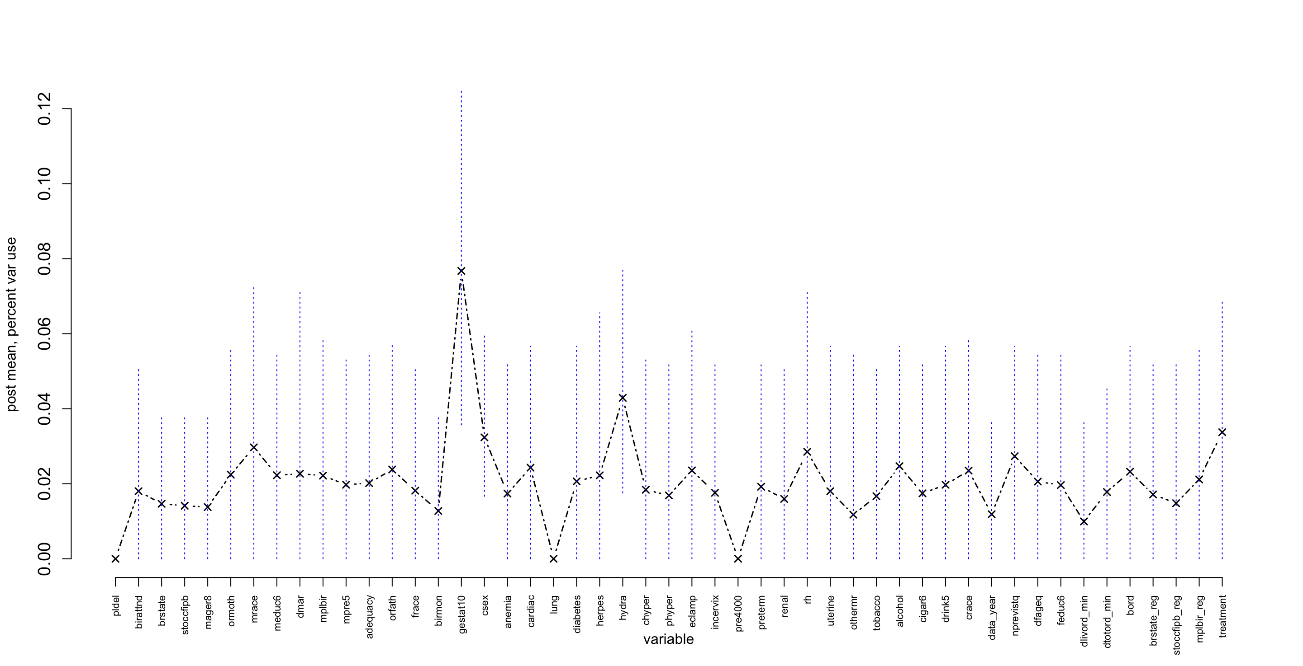
gestat10
csex
hydra
Post Mean, Percent Variable Use
treatment
Variable

Slide 2
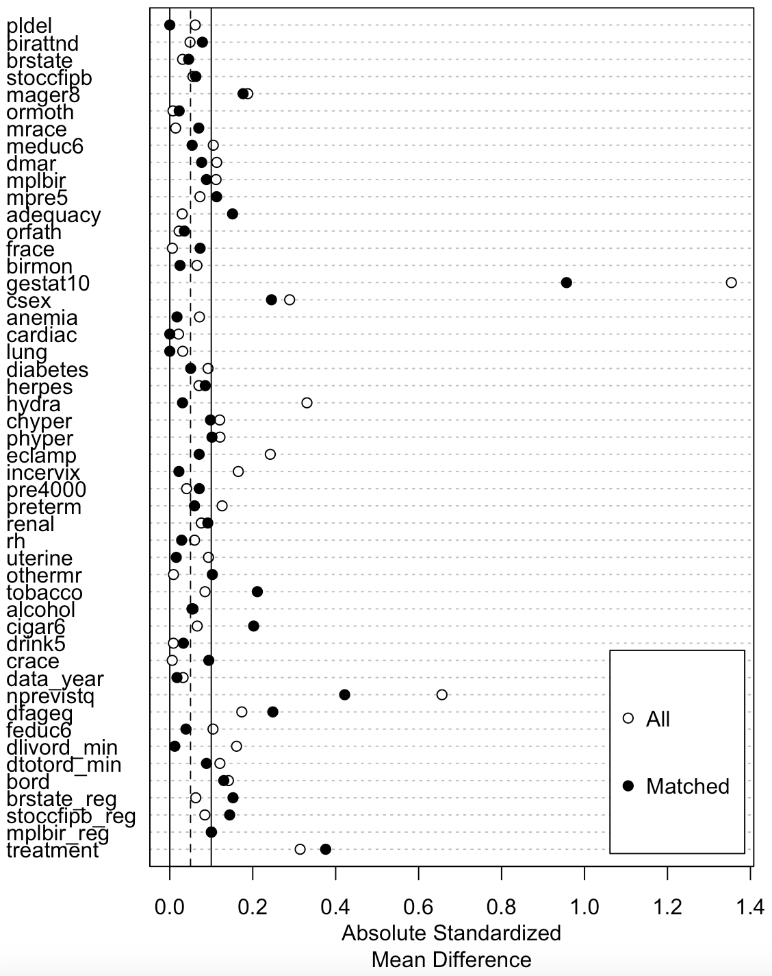
Absolute Standardized Mean Difference
No Change
Improved
Worsened

